Slide 1


Enhancing Property Specification of Cyber-Physical Systems using Negative Selection
João Paulo Araujo
20/0099663

Slide 2
Índice
Introduction
Background
Cyber-Physical Systems
System Verification
Biological Immune System
Negative Selection Algorithm
Methodology
Innate Immunity through Assurances
Adaptive Immunity through learning
Related Work
Schedule

Slide 3

Introdução

Slide 4
Cyber-physical systems

Slide 5

Background

Slide 6
Distances
1
1
0
1
0
0
1
0
1
1
0
0
0
1
1
1
0
0
0
0
0
1
0
1
1
1
1
0
0
1
R-contiguous bits
r = 5
*
*
*
*
*
0
1
0
1
1
*
*
*
*
*
R-chunk
r = 5
1
0
0
0
0
0
1
0
1
1
1
1
0
0
1
Hamming Distance
1
1
0
1
0
0
1
0
1
1
0
0
0
1
1

Slide 7
Cyber-physical systems

Slide 8
System verification

Slide 9
Model checking

Slide 10
Modelica

Slide 11
Goal-oriented requirements engineering

Slide 12
Biological immune system

Slide 13
Negative selection algorithm

Slide 14


Enhancing Property Specification of Cyber-Physical Systems using Negative Selection

Slide 15
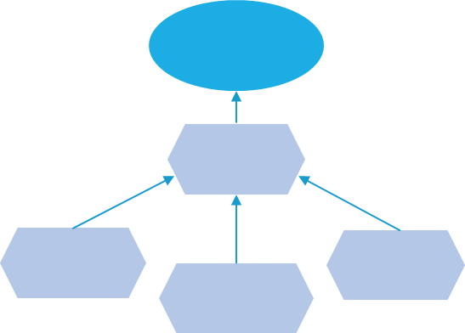


Overview
A. Innate Immunity Through Assurances
Design Process
System Model
Prototype Implementation
CGM
System Prototype
Property Specification
System Properties
Model Checking
Operation Dataset
B. Adaptive Immunity Through Learning
Negative Selection
Pattern Analysis
Feature Engineering
Data Labeling
Data Processing
Non-Self
Detector Generator
Dataset
Self

Slide 16
A. Innate Immunity Through Assurances
A. Innate Immunity Through Assurances
Design Process
System Model
Prototype Implementation
CGM
System Prototype
Property Specification
System Properties
Model Checking
Operation Dataset
B. Adaptive Immunity Through Learning
Negative Selection
Pattern Analysis
Feature Engineering
Data Labeling
Data Processing
Non-Self
Detector Generator
Dataset
Self

Slide 17
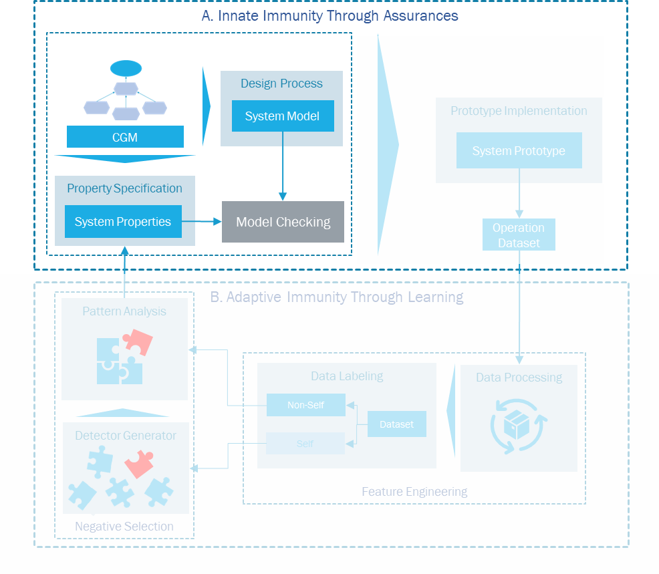
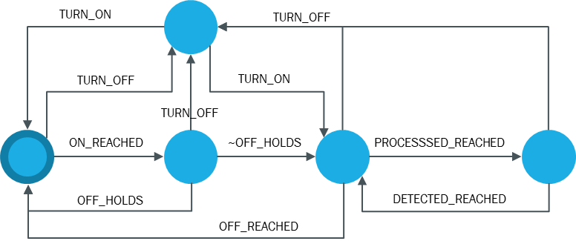
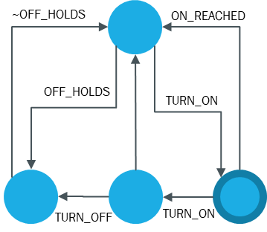
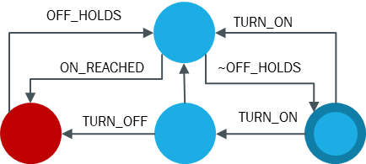
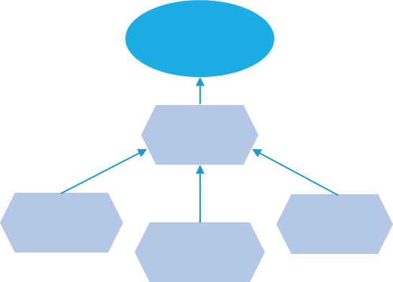

A. Innate Immunity Through Assurances
Observer
System Model
Model Checking
$$¬φ→∅$$
CGM
Property
Observer Catalog
PSP Catalog

Slide 18
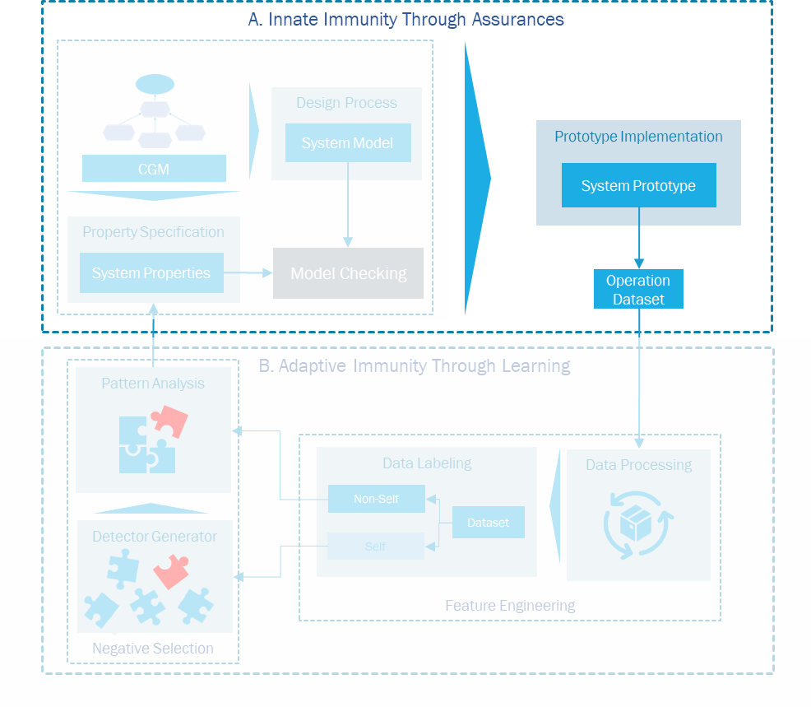
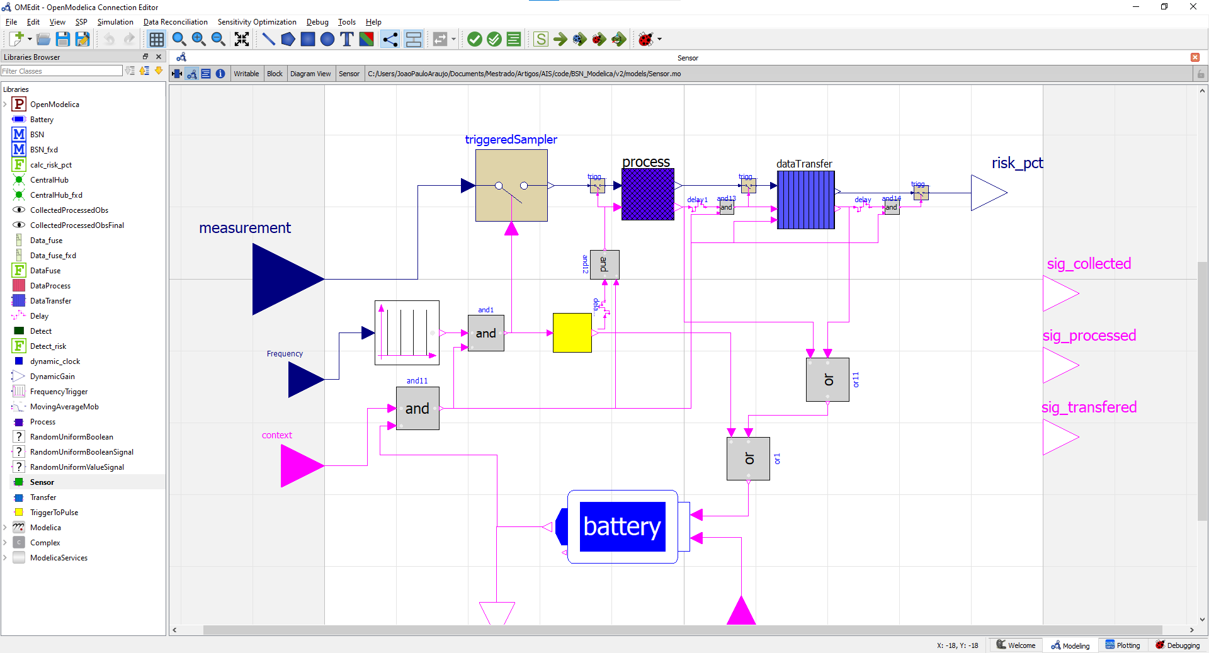
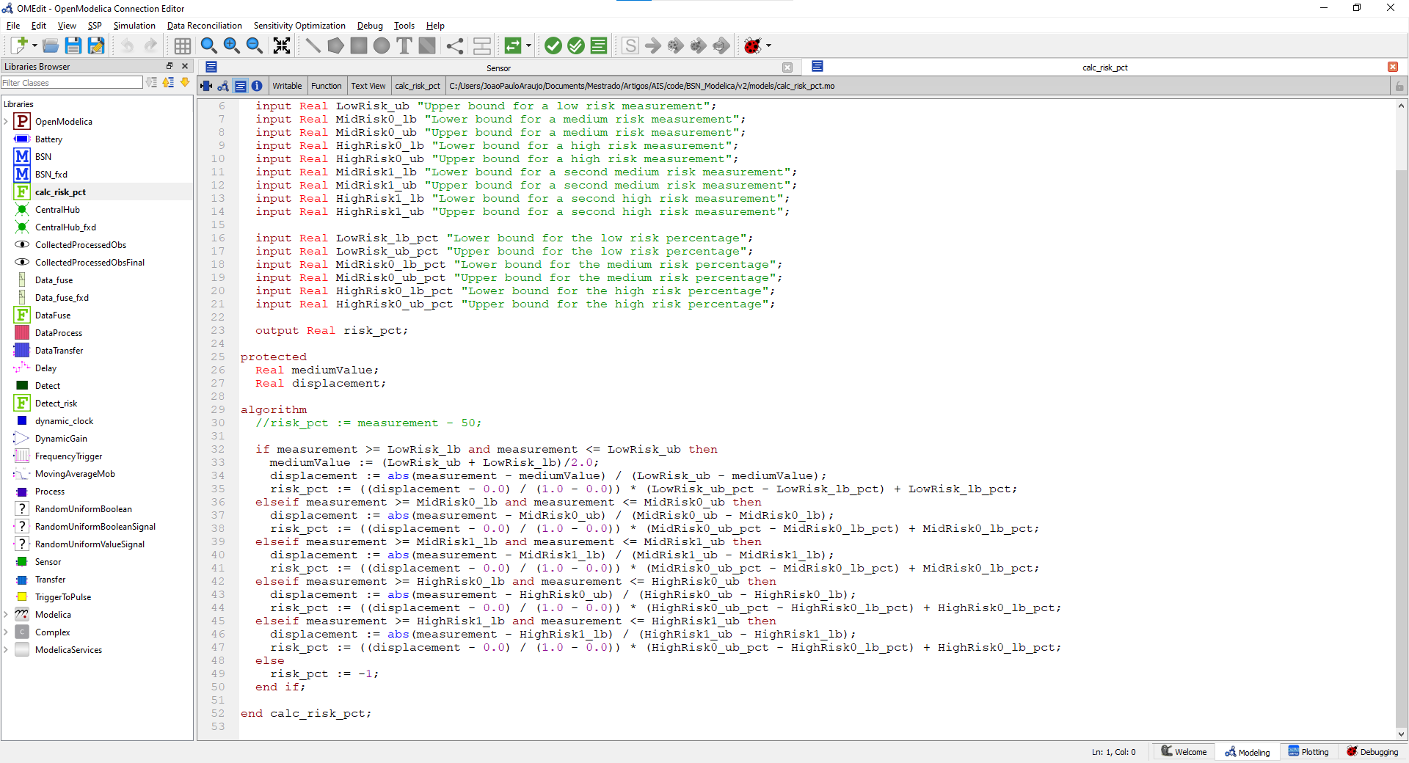
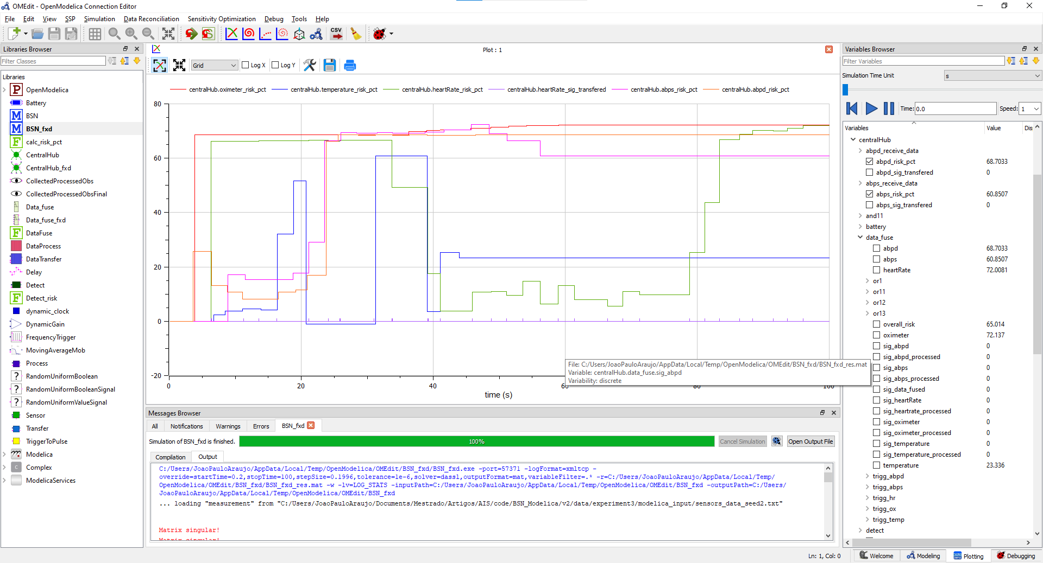


Prototype Implementation

Slide 19
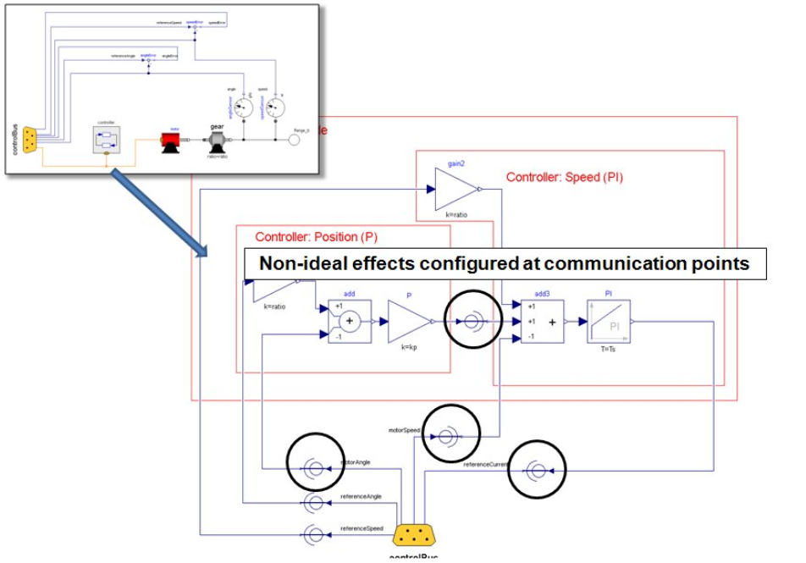
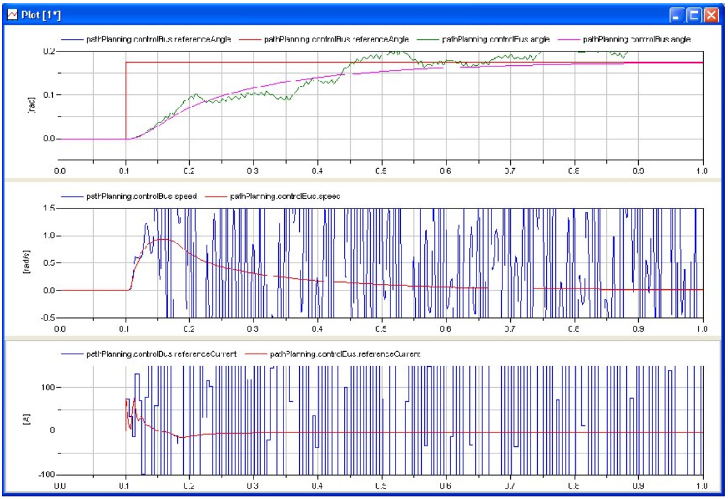
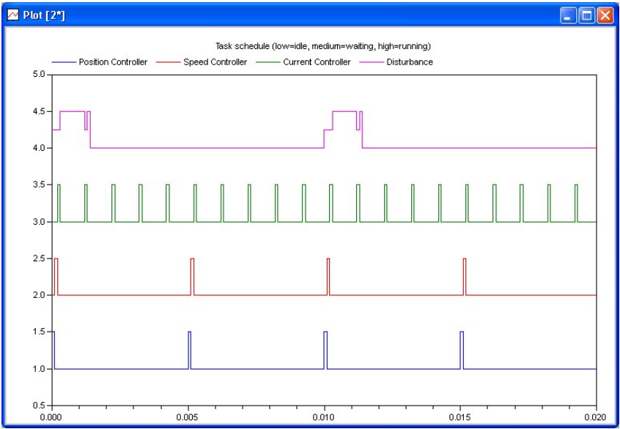
Prototype Implementation

Slide 20
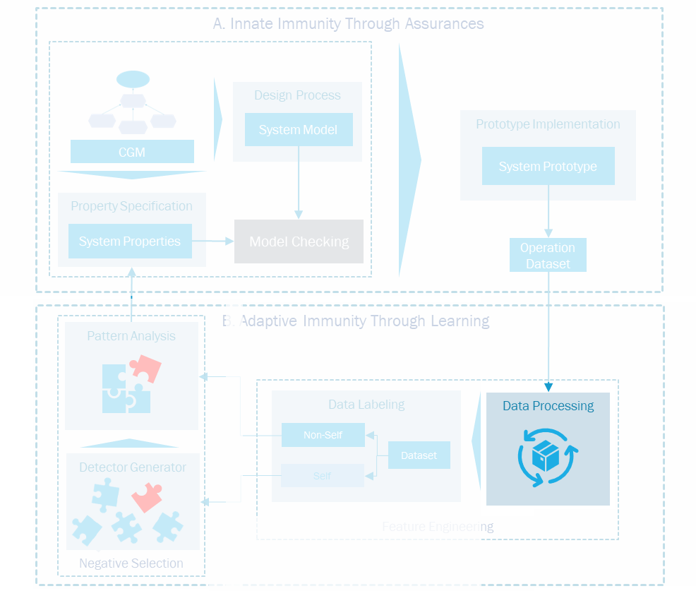
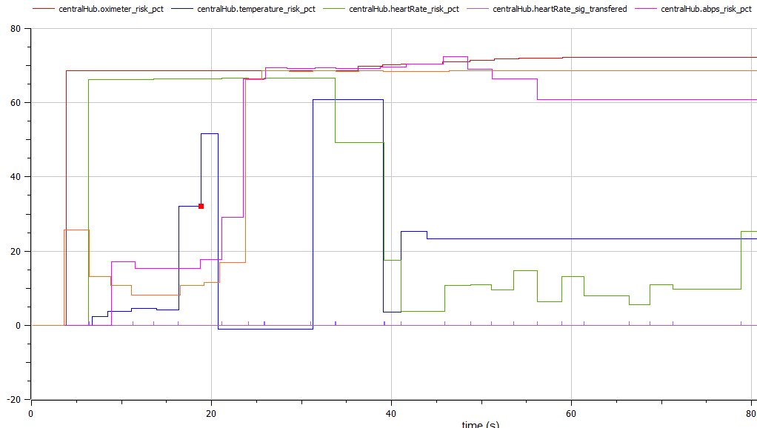
Prototype Implementation
Time | Context | Collected | Processed | Transfered | Central
0 | 1 | 0 | 0 | 0 | 0
0.5 | 1 | 1 | 0 | 0 | 0
1 | 1 | 0 | 1 | 0 | 0
1.5 | 1 | 0 | 0 | 0 | 0
2 | 0 | 0 | 0 | 1 | 0
2.5 | 1 | 0 | 0 | 0 | 1
3 | 1 | 0 | 0 | 0 | 0
3.5 | 1 | 1 | 0 | 0 | 0
4 | 0 | 0 | 0 | 0 | 0
4.5 | 1 | 0 | 1 | 0 | 0
5 | 1 | 0 | 0 | 0 | 0
5.5 | 1 | 0 | 0 | 0 | 1
6 | 1 | 1 | 0 | 0 | 0
Time | Context | Collected | Processed | Transfered | Central
0 | 1 | 0 | 0 | 0 | 0
0.5 | 1 | 1 | 0 | 0 | 0
1 | 1 | 0 | 1 | 0 | 0
1.5 | 1 | 0 | 0 | 0 | 0
2 | 0 | 0 | 0 | 1 | 0
2.5 | 1 | 0 | 0 | 0 | 1
3 | 1 | 0 | 0 | 0 | 0
3.5 | 1 | 1 | 0 | 0 | 0
4 | 0 | 0 | 0 | 0 | 0
4.5 | 1 | 0 | 1 | 0 | 0
5 | 1 | 0 | 0 | 0 | 0
5.5 | 1 | 0 | 0 | 0 | 1
6 | 1 | 1 | 0 | 0 | 0
Time | Context | Collected | Processed | Transfered | Central
0 | 1 | 0 | 0 | 0 | 0
0.5 | 1 | 1 | 0 | 0 | 0
1 | 1 | 0 | 1 | 0 | 0
1.5 | 1 | 0 | 0 | 0 | 0
2 | 0 | 0 | 0 | 1 | 0
2.5 | 1 | 0 | 0 | 0 | 1
3 | 1 | 0 | 0 | 0 | 0
3.5 | 1 | 1 | 0 | 0 | 0
4 | 0 | 0 | 0 | 0 | 0
4.5 | 1 | 0 | 1 | 0 | 0
5 | 1 | 0 | 0 | 0 | 0
5.5 | 1 | 0 | 0 | 0 | 1
6 | 1 | 1 | 0 | 0 | 0
Time | Context | Collected | Processed | Transfered | Central
0 | 1 | 0 | 0 | 0 | 0
0.5 | 1 | 1 | 0 | 0 | 0
1 | 1 | 0 | 1 | 0 | 0
1.5 | 1 | 0 | 0 | 0 | 0
2 | 0 | 0 | 0 | 1 | 0
2.5 | 1 | 0 | 0 | 0 | 1
3 | 1 | 0 | 0 | 0 | 0
3.5 | 1 | 1 | 0 | 0 | 0
4 | 0 | 0 | 0 | 0 | 0
4.5 | 1 | 0 | 1 | 0 | 0
5 | 1 | 0 | 0 | 0 | 0
5.5 | 1 | 0 | 0 | 0 | 1
6 | 1 | 1 | 0 | 0 | 0
Operation Dataset

Slide 21
B. Adaptive Immunity Through Learning
A. Innate Immunity Through Assurances
Design Process
System Model
Prototype Implementation
CGM
System Prototype
Property Specification
System Properties
Model Checking
Operation Dataset
B. Adaptive Immunity Through Learning
Negative Selection
Pattern Analysis
Feature Engineering
Data Labeling
Data Processing
Non-Self
Detector Generator
Dataset
Self

Slide 22
Data Processing
Time | Context | Collected | Processed | Transfered | Central_processed
0 | 1 | 0 | 0 | 0 | 0
0.5 | 1 | 1 | 0 | 0 | 0
1 | 1 | 0 | 1 | 0 | 0
1.5 | 1 | 0 | 0 | 0 | 0
2 | 0 | 0 | 0 | 1 | 0
2.5 | 1 | 0 | 0 | 0 | 1
3 | 1 | 0 | 0 | 0 | 0
3.5 | 1 | 1 | 0 | 0 | 0
4 | 0 | 0 | 0 | 0 | 0
4.5 | 1 | 0 | 1 | 0 | 0
5 | 1 | 0 | 0 | 0 | 0
5.5 | 1 | 0 | 0 | 0 | 1
6 | 1 | 1 | 0 | 0 | 0
0 | 1 | 0 | 0 | 0 | 0
P8
If the sensor collected some data, then the central node will process it.
Time restricted
T= 2s
Attribute Based
P8
If the sensor collected some data, then, in 2 seconds, the central node will process it.
3.5 | 1 | 1 | 0 | 0 | 0
4 | 0 | 0 | 0 | 0 | 0
4.5 | 1 | 0 | 1 | 0 | 0
5 | 1 | 0 | 0 | 0 | 0
5.5 | 1 | 0 | 0 | 0 | 1
6 | 1 | 1 | 0 | 0 | 0
Next Segment

Slide 23
Data Processing
Time | Context | Collected | Processed | Transfered | Central_processed
0 | 1 | 0 | 0 | 0 | 0
0.5 | 1 | 1 | 0 | 0 | 0
1 | 1 | 0 | 1 | 0 | 0
1.5 | 1 | 0 | 0 | 0 | 0
2 | 0 | 0 | 0 | 1 | 0
2.5 | 1 | 0 | 0 | 0 | 1
3 | 1 | 0 | 0 | 0 | 0
3.5 | 1 | 1 | 0 | 0 | 0
Was it present at all times?
Segment Number | Sensor Collected | Sensor Processed | Sensor Transfered | Central node Processed | Context Always present | Time between process and transfer | Time until Central Node processed
1
1
1
1
1
0
0
0.5
null

Slide 24
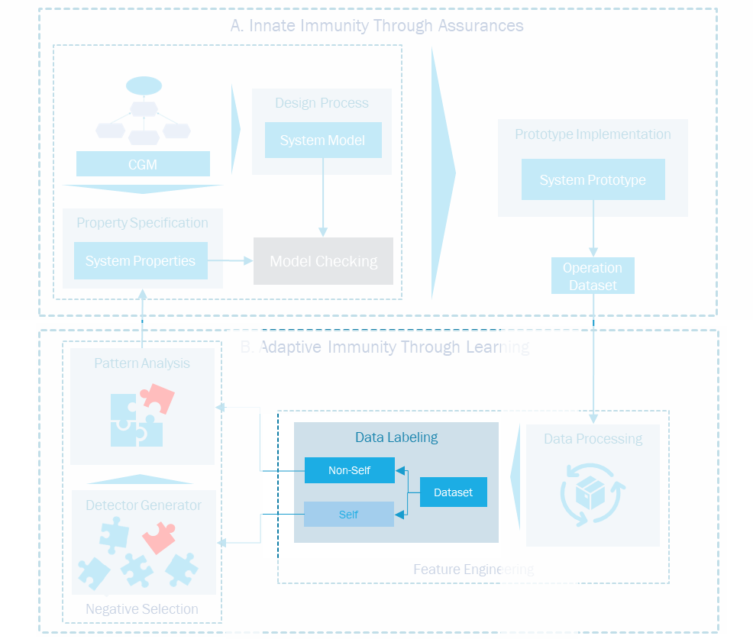
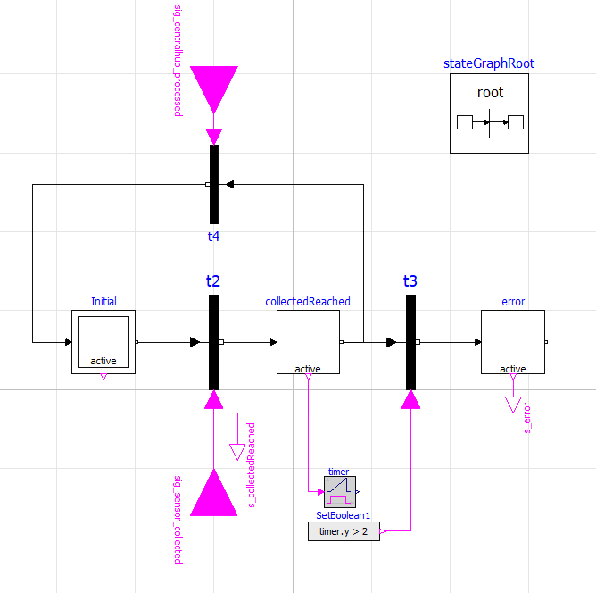
Data labeling
Central node Processed
Sensor Collected
Timer
Segment Number | Sensor Collected | Sensor Processed | Sensor Transfered | Central node Processed | Context Always present | Time between process and transfer | Time until Central Node processed
1
Label
1
1
1
1
0
0
0.5
null
1

Slide 25
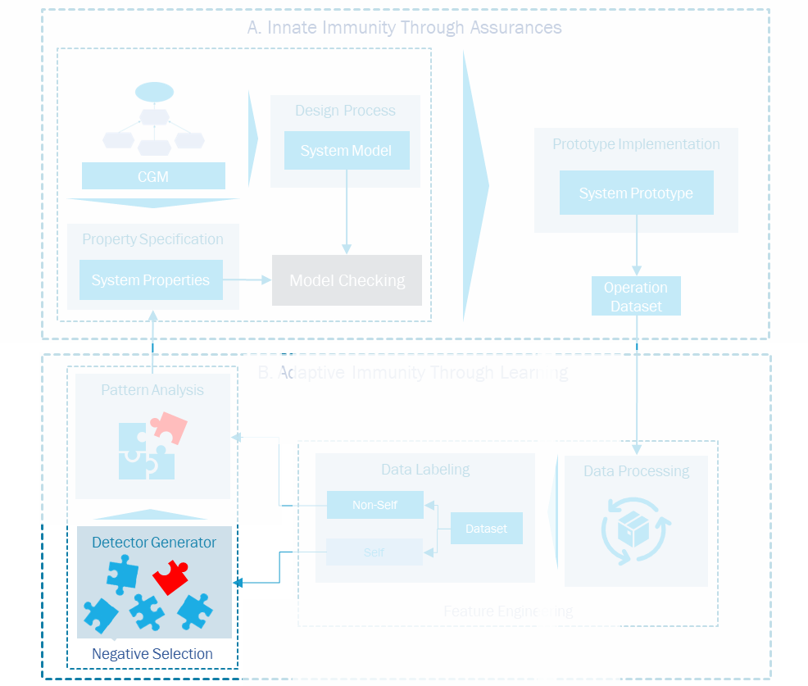
Exploratory data analysis
Missing Data
Correlation
Context Always present
0.8465
Sensor Transfered
-0.6488
Data types
Sensor Collected
-0.5544
Central Node Processed
0.5312
Sensor Processed
0.3144
Threshold
Behavior
0.1797
Emergency detected
Central Node Persisted
-0.5655

Slide 26
String Formatting
Context Always present | Transfered | Collected | Central Node processed | Processed
0 | 1 | 1 | 0 | 1
Label
0
0
1
1
0
1
Self

Slide 27
Train-test split
Train
Test
Nonself
Self
Test
How does the model generalize?
Property Violations
Regular Execution

Slide 28

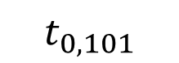
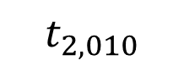
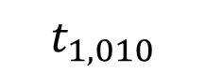
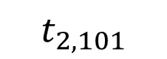


Detector Generation
Self-set
0
1
1
1
1
1
1
0
1
0
0
0
1
1
1
0
1
0
0
1
Match?
No, accept!
$$t_{1, 010}$$
$$t_{2, 010}$$
0
1
0
0
0
1
1
1
$$t_{2, 101}$$
$$t_{0, 101}$$
1
0
1
*
0
1
0
*
Detectors
Candidate Detectors
Yes, discard!
$$t_{0, 010}$$
$$t_{1, 101}$$

Slide 29
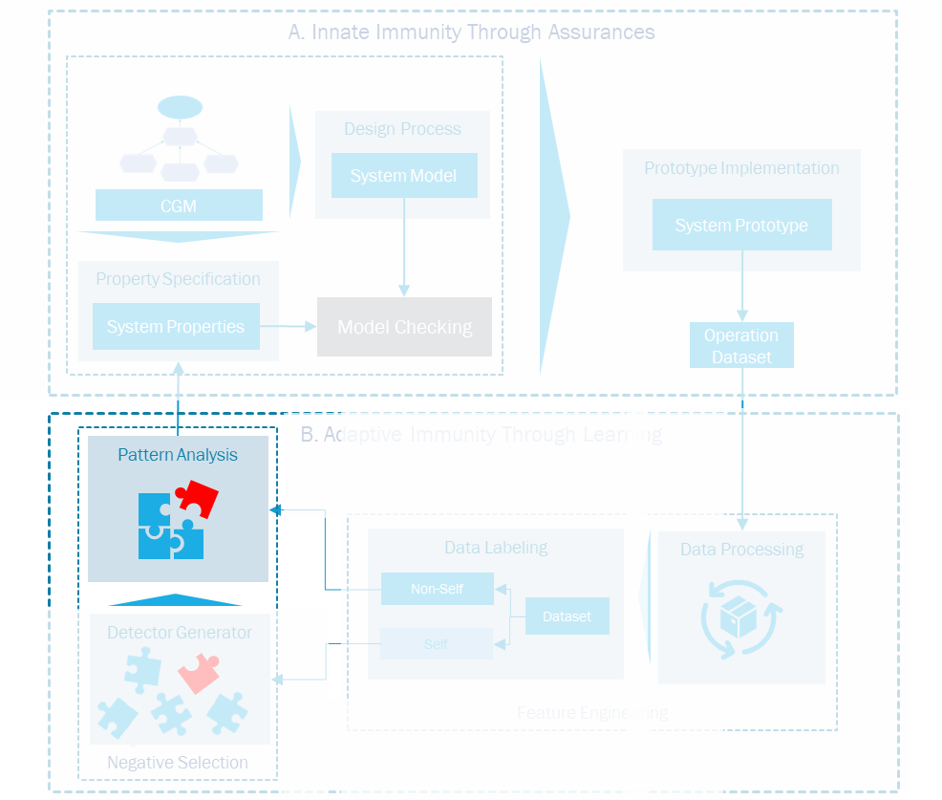
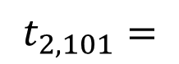
Pattern analysis
Position | Feature
0 | Context Always present
1 | Transfered
2 | Collected
3 | Central Node processed
4 | Processed
$$t_{2, 101}=$$
1
0
1

Slide 30

Related work

